Slide 1

IN
SOUTH FLORIDA OPERATING ENGINEERS
APPRENTICE AND TRAINING FUND
Board of directors
MEETING
NOVEMBER 11, 2021

Slide 2
Topics For Discussion
Overview
Financial Overview
Other Matters

Slide 3
Overview

Slide 4




AUDIT TEAM
Dina Bellows-Levine, CPA Partner
Jennifer R. Koffman, CPA Partner
Kyle Nelson , CPA Manager
Michael Modreck Senior
Patty Reyes, CPA Staff

Slide 5
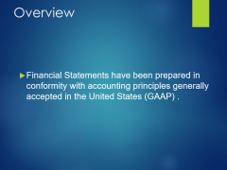
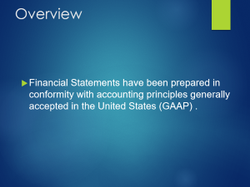
Overview
  Financial Statements have been prepared in conformity with accounting principles generally accepted in the United States (GAAP) .

Slide 6
Financial Overview

Slide 7
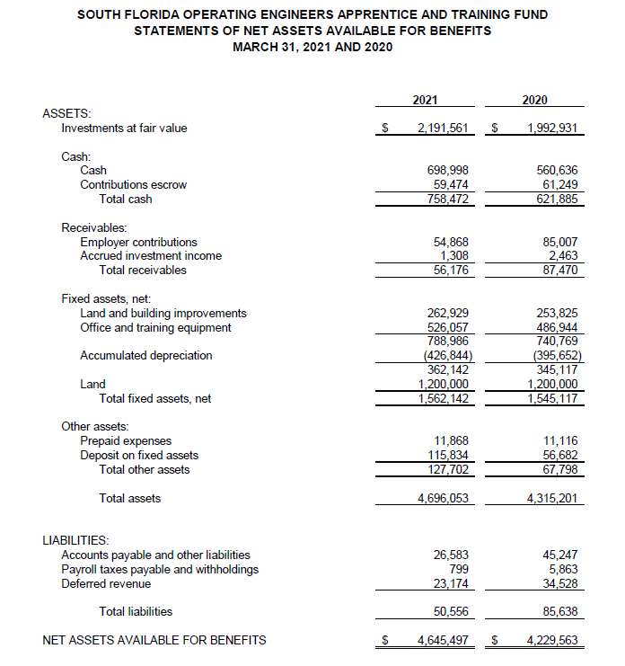

Slide 8
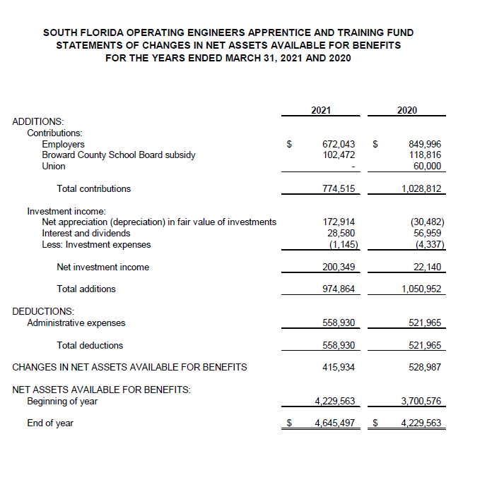

Slide 9
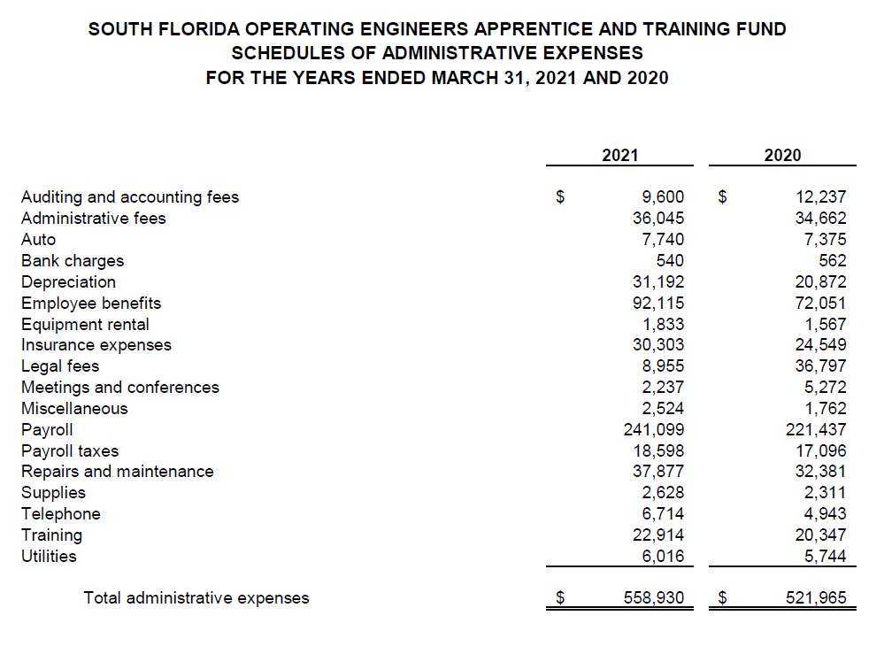

Slide 10
Other Matters

Slide 11

MATTERS TO DISCUSS
AFTER THE AUDIT

Slide 12

observations
Post audit communications

Slide 13
OBSERVATIONS
MANAGEMENT TEAM COOPERATIVE WITH REQUESTED INFORMATION
NAVIGATING THROUGH COVID-19

Slide 14
POST COMMUNICATION
Qualitative Aspects of Accounting Practices
Difficulties Encountered in Performing the Audit
Corrected and Uncorrected Misstatements
  An entry was made to record current year depreciation totaling $ 31,192
Disagreements with Management
Management Representations
Management Consultations with Other Independent Accountants
Other Audit Findings or Issues

Slide 15






